Slide 1
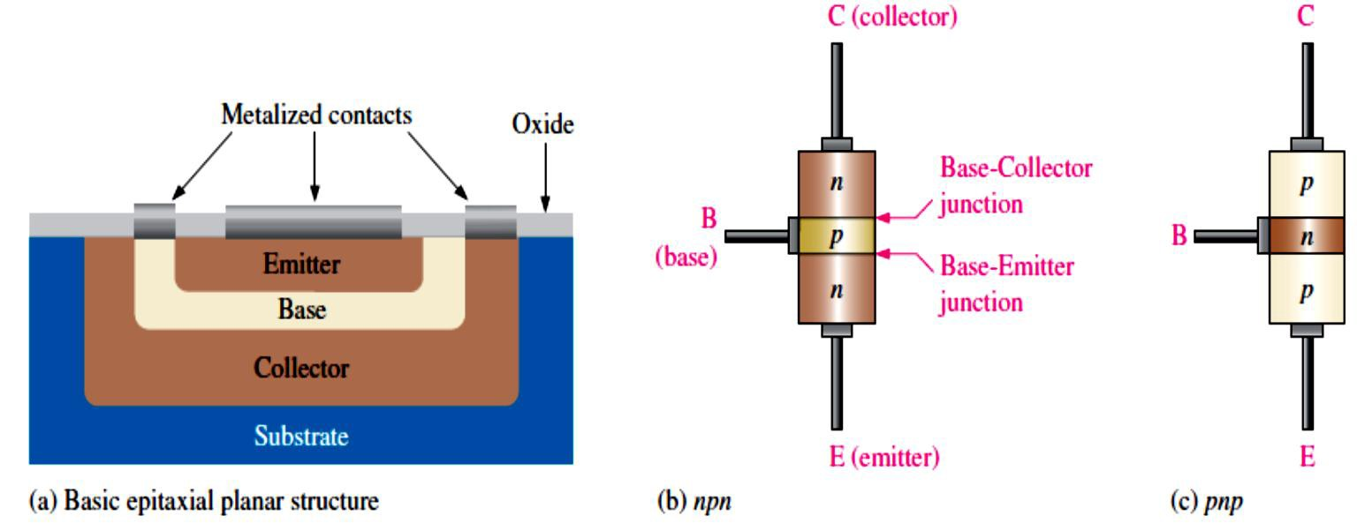
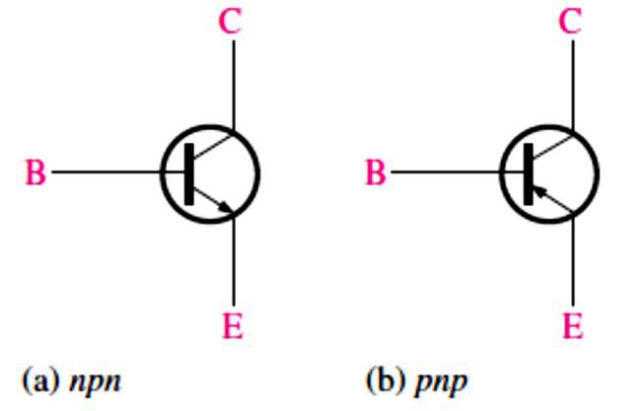
Lecture 4: Bipolar Junction Transistors
The invention of the semiconductor transistor was the beginning of a technological revolution of the complex electronic devices and systems.
Two basic types of transistors are the bipolar junction transistor (BJT) and the field-effect transistor (FET).
The BJT is used in two broad areas: as a linear amplifier and as an electronic switch.
4.1 Bipolar Junction Transistor (BJT) Structure
The BJT is constructed with three doped semiconductor regions: emitter, base, and collector, as shown in Figure 4-1.
The BJT has two pn junctions, the base-emitter (BE) junction and the base-collector (BC) junction.
Current in a BJT consists of both free electrons and holes, thus the term bipolar.
The base region is very thin and lightly doped compared to the collector and emitter regions.
The two types of BJT are the npn and the pnp, as shon in figure 4-2.
FIGURE 4-1: Basic BJT construction.
FIGURE 4-2: Standard BJT (bipolar junction transistor) symbols.

Slide 2
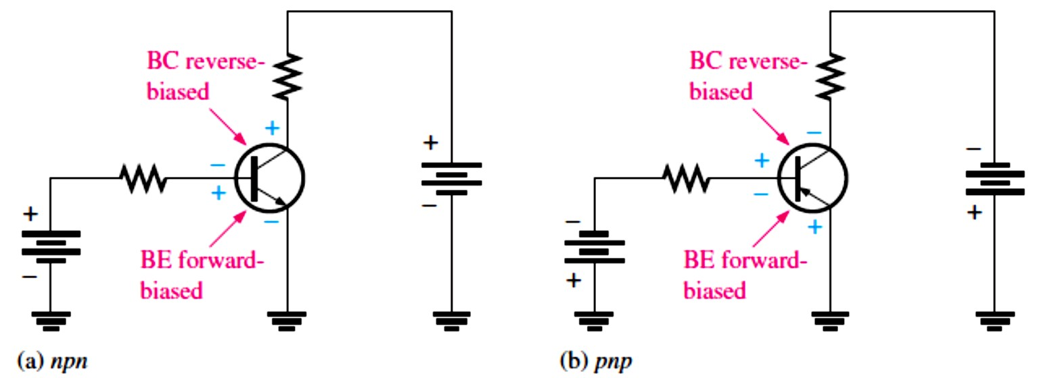
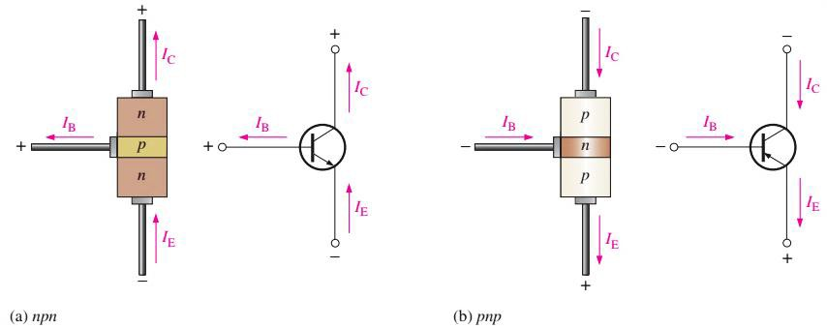
4.2 Basic BJT Operation
To operate a BJT as an amplifier, as shown in Figure 4-3, the BE junction must be forward- biased and the BC junction must be reverse-biased with external dc voltages. This is called forward-reverse bias.
The three currents in the transistor are the base current (𝐼_{B}), emitter current (𝐼_{E}), and collector current (𝐼_{C}), as shown in Figure 4-4.
The 𝐼_{E} is expressed as follows:
𝐼_{E} = 𝐼_{C} + 𝐼_{B}
𝐼_{B} is very small compared to 𝐼_{C} and 𝐼_{E}.
Equation 4– 1
FIGURE 4-3: Forward-reverse bias of a BJT.
FIGURE 4-4: Transistor currents.
4.3 BJT Characteristics and Parameters
The dc current gain of a transistor is the ratio of 𝐼_{C} to 𝐼_{B} and is designated dc beta (�_{DC}).
Values typically range from less than 20 to 200 or higher.
�_{DC} = 𝐼_{C}⁄𝐼_{B}
Equation 4– 2

Slide 3
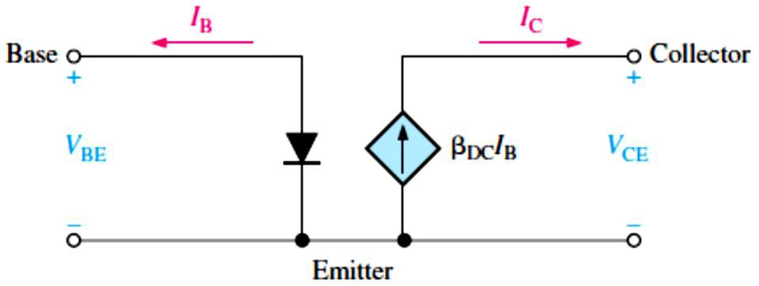
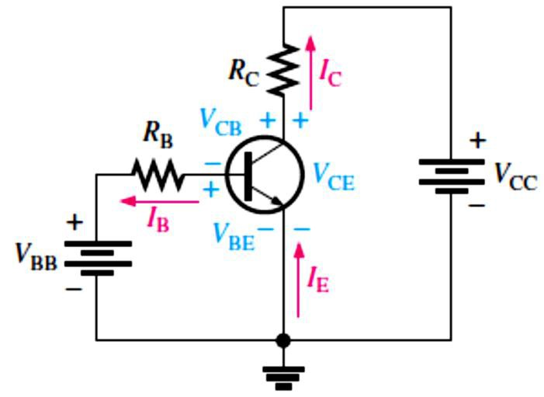
�_{DC} is usually referred to as an equivalent hybrid (h) parameter, ℎ�� , on transistor datasheets.
^{ℎ}FE ^{= �}DC
The ratio of 𝐼_{C} to 𝐼_{E} is called the dc alpha (�_{DC}).
𝐼_{C}
�_{DC} = _{𝐼}
E
�_{DC} Values typically range from 0.95 to 0.99 or greater, but �_{DC} is always less than 1.
  The reason is that 𝐼_{C} is always slightly less than 𝐼_{E} by the amount of 𝐼_{B}.
There is a variation in �_{DC} over temperature and also from one transistor to another of the same type.
EXAMPLE 4-1: Determine the dc current gain �_{DC} and the emitter current 𝐼_{E} for a transistor where 𝐼_{B} = 50 𝜇A and 𝐼_{C} = 3.65 mA.
Solution
�_{DC} = _{𝐼}=
𝐼_{C} 3.65 mA
= 73
B
50 𝜇A
𝐼_{E} = 𝐼_{C} + 𝐼_{B} = 3.65 mA + 50 𝜇A = 3.70 mA
Transistor DC Model: We can view the unsaturated BJT as a device with a current input and a dependent current source in the output circuit, as shown in Figure 4-5 for an npn.
FIGURE 4-5: Ideal dc model of an npn transistor.
BJT Circuit Analysis: Consider the basic transistor bias circuit configuration in Figure 4-6.
Three transistor dc currents and three dc voltages can be identified.
𝐼_{B}: dc base current
𝐼_{E}: dc emitter current
𝐼_{C}: dc collector current
�_{BE}: dc voltage at base with respect to emitter
�_{CB}: dc voltage at collector with respect to base
�_{CE}: dc voltage at collector with respect to emitter
FIGURE 4-6: Transistor currents and voltages.

Slide 4
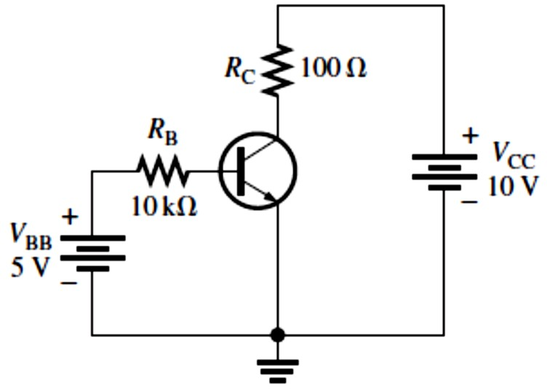
The base-bias voltage source, �_{BB}, forward-biases the BE junction, and the collector-bias voltage source, �_{CC}, reverse-biases the BC junction.
When the BE junction is forward-biased, it is like a forward-biased diode and has a nominal forward voltage drop of
�_{BE} ≅ 0.7 V
Equation 4– 3
Since the emitter is at ground (0 V), by Kirchhoff’s voltage law, the voltage across 𝑅_{B} is
�_{𝑅B} = �_{BB} − �_{BE}
Also, by Ohm’s law,
�_{𝑅B} = 𝐼_{B}𝑅_{B}
Substituting for �_{𝑅B} yields
𝐼_{B}𝑅_{B} = �_{BB} − �_{BE}
Solving for 𝐼_{B},
𝐼_{B} =
�BB ^{− �}BE
Equation 4– 4
𝑅
B
The voltage at the collector with respect to the grounded emitter is
�_{CE} = �_{CC} − �_{𝑅C}
Since the drop across 𝑅_{C} is
�_{𝑅C} = 𝐼_{C} 𝑅_{C}
the voltage at the collector with respect to the emitter can be written as
�_{CE} = �_{CC} − 𝐼_{C} 𝑅_{C}
Equation 4– 5
where 𝐼_{C} = �_{DC}𝐼_{B}.
The voltage across the reverse-biased collector-base junction is
�CB ^{= �}CE ^{− �}BE
Equation 4– 6
EXAMPLE 4-2: Determine 𝐼_{B}, 𝐼_{C}, 𝐼_{E}, �_{BE}, �_{CE}, and �_{CB} in the circuit of Figure 4-7. The transistor has a �_{DC} = 150.
FIGURE 4-7
Solution From Equation 4-3, �_{BE} ≅ 0.7 V. Calculate the base, collector, and emitter currents as follows:
𝐼_{B} =
�BB ^{− �}BE
5 V − 0.7 V
𝑅
= = 430 𝜇A
B
10 kΩ
𝐼_{C} = �_{DC}𝐼_{B} = (150)(430 𝜇A) = 64.5 mA
𝐼_{E} = 𝐼_{C} + 𝐼_{B} = 64.5 mA + 430 𝜇A = 64.9 mA
Solve for �_{CE} and �_{CB}.

Slide 5
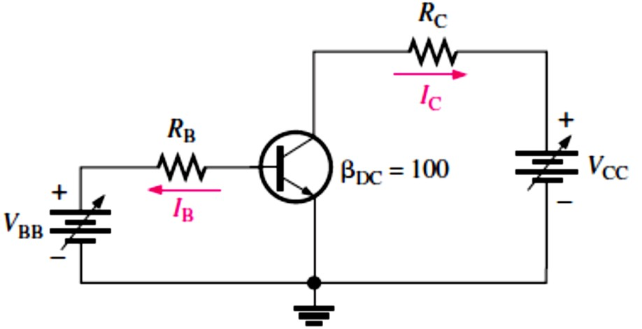
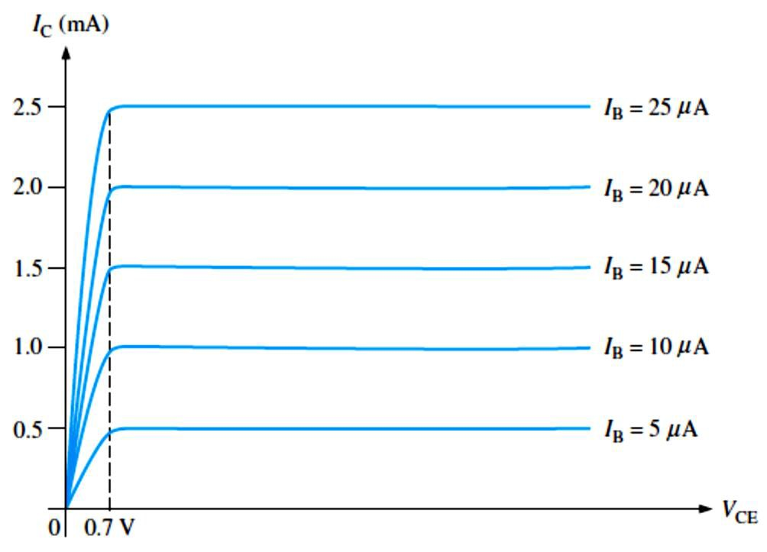
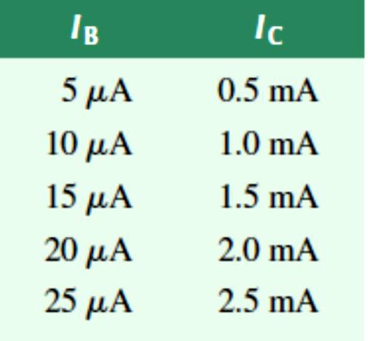
�_{CE} = �_{CC} − 𝐼_{C} 𝑅_{C} = 10 V − (64.5 mA)(100 Ω) = 10 V − 6.45 V = 3.55 V
�_{CB} = �_{CE} − �_{BE} = 3.55 V − 0.7 V = 2.85 V
Since the collector is at a higher voltage than the base, the CB junction is reverse-biased.
EXAMPLE 4-3: Sketch an ideal family of collector curves for the circuit in Figure 4-8 for 𝐼_{B} = 5 𝜇A to 25 𝜇A in 5 𝜇A increments. Assume �_{DC} = 100 and that �_{CE} does not exceed breakdown.
FIGURE 4-8
Solution Using the relationship 𝐼_{C} = �_{DC}𝐼_{B}, values of 𝐼_{C} are calculated and tabulated in Table 4-1. The resulting curves are plotted in Figure 4-9.
TABLE 4-1
FIGURE 4-9
Cutoff: When 𝐼_{B} = 0, the transistor is in the cutoff region of its operation. This is shown in Figure 4-10 with the base lead open, resulting in a base current of zero.
  Under this condition, there is a very small amount of collector leakage current, 𝐼_{CEO}, due mainly to thermally produced carriers.
In cutoff, neither the BE nor the BC junctions are forward-biased.

Slide 6
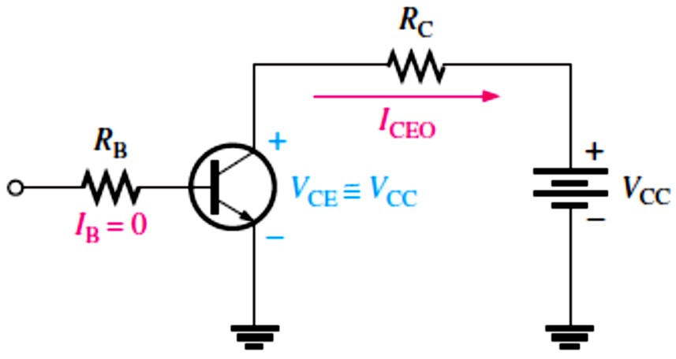
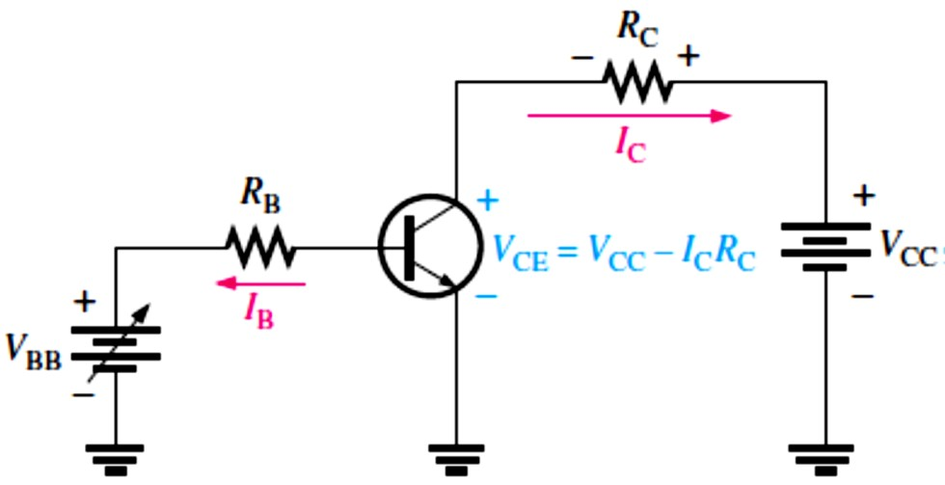
FIGURE 4-10: Cutoff: Collector leakage current (𝐼_{CEO}) is extremely small and is usually neglected. Base- emitter and base-collector junctions are reverse-biased.
Saturation: When the BE junction becomes forward-biased and the base current is increased, the collector current also increases (𝐼_{C} = �_{DC}𝐼_{B}) and �_{CE} decreases as a result of more drop across the collector resistor (�_{CE} = �_{CC} − 𝐼_{C} 𝑅_{C}). This is illustrated in Figure 4-11.
When �_{CE} reaches its saturation value, �_{CE(sat)}, the BC junction becomes forward-biased and
𝐼_{C} can increase no further even with a continued increase in 𝐼_{B}. At the point of saturation, the relation 𝐼_{C} = �_{DC}𝐼_{B} is no longer valid.
FIGURE 4-11: Saturation: As 𝐼_{B} increases due to increasing �_{BB}, 𝐼_{C} also increases and �_{CE} decreases due to the increased voltage drop across 𝑅_{C}. When the transistor reaches saturation, 𝐼_{C} can increase no further regardless of further increase in 𝐼_{B}. Base-emitter and base-collector junctions are forward-biased.
DC Load Line: Cutoff and saturation can be illustrated in relation to the collector characteristic curves by the use of a dc load line, as shown in Figure 4-12.
The bottom of the dc load line is at ideal cutoff where 𝐼_{C} = 0 and �_{CE} = �_{CC}.
The top of the dc load line is at saturation where 𝐼_{C} = 𝐼_{C(sat)} and �_{CE} = �_{CE(sat)}.
In between cutoff and saturation along the dc load line is the active , or linear, region of the transistor’s operation.

Slide 7
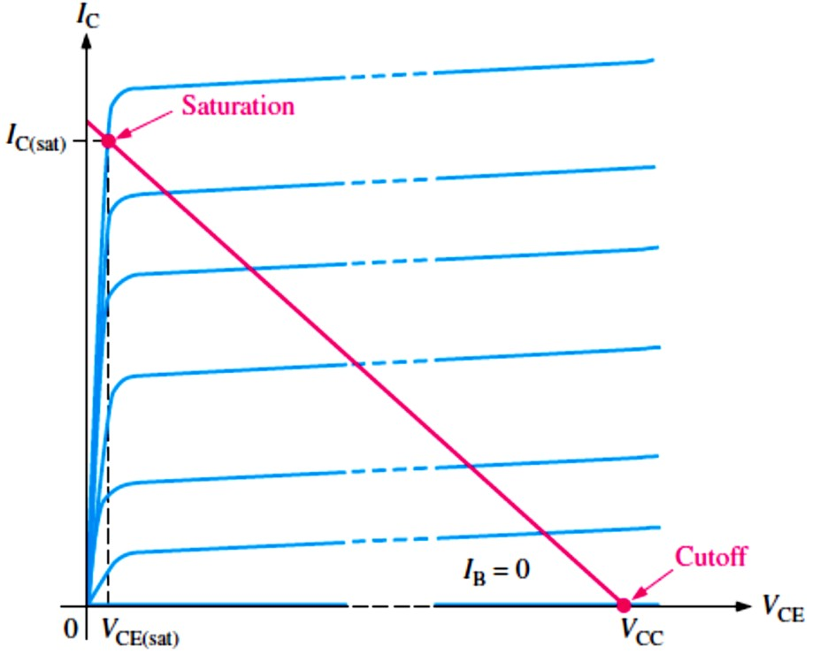
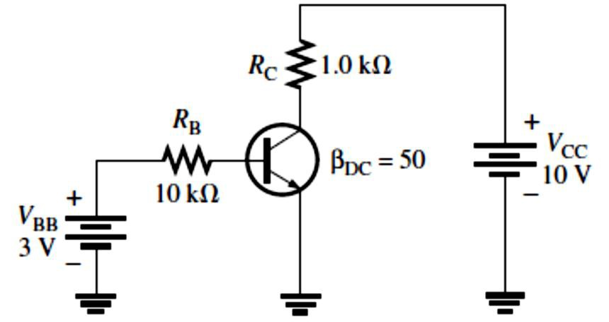
FIGURE 4-12: DC load line on
a family of collector characteristic curves illustrating the cutoff and saturation conditions.
EXAMPLE 4–4: Determine whether or not the transistor in Figure 4-13 is in saturation. Assume
�_{CE(sat)} = 0.2 V.
FIGURE 4-13
Solution First, determine 𝐼_{C(sat)}.
^{𝐼}C(sat) ⁼
�CC ^{− �}CE(sat)
=
10 V − 0.2 V
𝑅
C
1.0 kΩ
9.8 V
𝐼_{C(sat)} = _{1.0 kΩ} = 9.8 mA
Now, we see if 𝐼_{B} is large enough to produce 𝐼_{C(sat)}.
𝐼_{B} =
�BB ^{− �}BE
3 V − 0.7 V
𝑅
= = 0.23 mA
B
10 kΩ
𝐼_{C} = �_{DC}𝐼_{B} = (50)(0.23 mA) = 11.5 mA
This shows that with the specified �_{DC}, this base current is capable of producing an 𝐼_{C} greater than 𝐼_{C(sat)}. Therefore, the transistor is saturated, and the collector current value of 11.5 mA is never reached. If we further increase 𝐼_{B}, the collector current remains at its saturation value of 9.8 mA.
Maximum Transistor Ratings: A BJT, like any other electronic device, has limitations on its operation. These limitations are stated in the form of maximum ratings and are normally specified on the manufacturer’s datasheet.

Slide 8
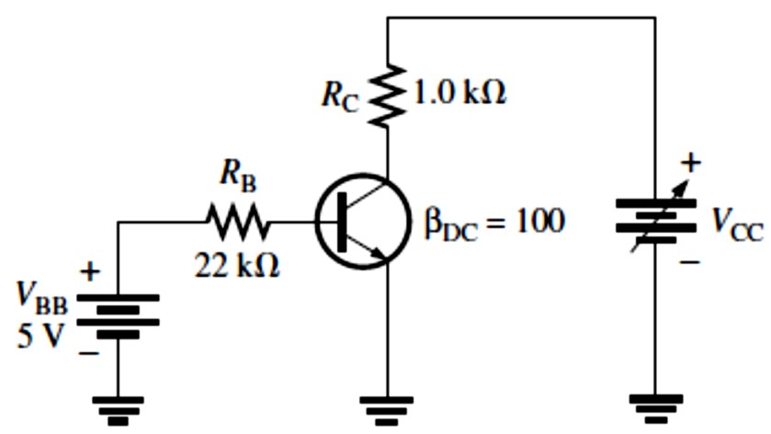
Typically, maximum ratings are given for collector-to-base voltage, collector-to-emitter voltage, emitter-to-base voltage, collector current, and power dissipation.
The product of �_{CE} and 𝐼_{C} must not exceed the maximum power dissipation. Both �_{CE} and 𝐼_{C}
cannot be maximum at the same time. If �_{CE} is maximum, 𝐼_{C} can be calculated as
𝐼_{C} =
�D(max)
𝑉
CE
If 𝐼_{C} is maximum, �_{CE} can be calculated by rearranging the previous equation as follows:
�_{CE} =
�D(max)
𝐼
C
EXAMPLE 4-5: A certain transistor is to be operated with �_{CE} = 6 V. If its maximum power rating is 250 mW, what is the most collector current that it can handle?
Solution
𝐼_{C} =
�D(max)
250 mW
𝑉
= = 41.7 mA
CE
6 V
This is the maximum current for this particular value of �_{CE}. The transistor can handle more collector current if �_{CE} is reduced, as long as �_{D(max)} and 𝐼_{C(max)} are not exceeded.
EXAMPLE 4-6: The transistor in Figure 4-14 has the following maximum ratings: �_{D(max)} = 800 mW, �_{CE(max)} = 15 V, and 𝐼_{C(max)} = 100 mA. Determine the maximum value to which �_{CC} can be adjusted without exceeding a rating. Which rating would be exceeded first?
FIGURE 4-14
Solution First, we find 𝐼_{B} so that we can determine 𝐼_{C}.
𝐼_{B} =
�BB ^{− �}BE
5 V − 0.7 V
𝑅
= = 195 μA
B
22 kΩ
𝐼_{C} = �_{DC} 𝐼_{B} = (100)(195 μA) = 19.5 mA
𝐼_{C} is much less than 𝐼_{C(max)} and ideally will not change with �_{CC}. It is determined only by 𝐼_{B} and
�_{DC}. The voltage drop across 𝑅_{C} is
�_{𝑅C} = 𝐼_{C} 𝑅_{C} = (19.5 mA)(1.0 kΩ) = 19.5 V
Now we can determine the value of �_{CC} when �_{CE} = �_{CE(max)} = 15 V.
�_{𝑅C} = �_{CC} − �_{CE}
So,
�_{CC(max)} = �_{CE(max)} + �_{𝑅C} = 15 V + 19.5 V = 34.5 V

Slide 9
�_{CC} can be increased to 34.5 V, under the existing conditions, before �_{CE(max)} is exceeded. However, at this point it is not known whether or not �_{D(max)} has been exceeded.
�_{D} = �_{CE(max)} 𝐼_{C} = (15 V)(19.5 mA) = 293 mW
Since �_{D(max)} is 800 mW, it is not exceeded when �_{CC} = 34.5 V. So, �_{CE(max)} =15 V is the limiting rating in this case. If the base current is removed causing the transistor to turn off,
𝑽_{��(�𝐚𝐱)} will be exceeded first because the entire supply voltage, �_{CC}, will be dropped across
the transistor.
Derating 𝑷_{�(�𝐚𝐱)}: �_{D(max)} is usually specified at 25°C. For higher temperatures, �_{D(max)} is less.
Datasheets often give derating factors for determining �_{D(max)} at any temperature above 25°C.
For example, a derating factor of 2 mW/°C indicates that the maximum power dissipation is reduced 2 mW for each degree Celsius increase in temperature.
EXAMPLE 4-7: A certain transistor has a �_{D(max)} of 1 W at 25°C. The derating factor is 5 mW/°C. What is the �_{D(max)} at a temperature of 70°C?
Solution The change (reduction) in �_{D(max)} is
Δ�_{D(max)} = (5 mW/°C)(70°C − 25°C) = (5 mW/°C)(45°C) = 225 mW
Therefore, �_{D(max)} at 70°C = 1 W − 225 mW = 775 mW
4.4 The BJT as an Amplifier
Amplification is the process of linearly increasing the amplitude of an electrical signal and is one of the major properties of a transistor.
As we learned, a BJT exhibits current gain (called �).
  When a BJT is biased in the active (or linear) region, as previously described, the BE junction has a low resistance due to forward bias and the BC junction has a high resistance due to reverse bias.
DC and AC Quantities: Before discussing the concept of transistor amplification, the designations that we will use for the circuit quantities of current, voltage, and resistance must
be explained because amplifier circuits have both dc and ac quantities.
Italic capital letters are used for both dc and ac currents (𝐼) and voltages (𝑉). This rule applies to rms, average, peak, and peak-to-peak ac values.
AC current and voltage values are always rms unless stated otherwise. The distinction between a dc current or voltage and an ac current or voltage is in the subscript.
DC quantities always carry an uppercase roman (nonitalic) subscript. For example, 𝐼_{B}, 𝐼_{C}, and
𝐼_{E} are the dc transistor currents. �_{BE}, �_{CB}, and �_{CE} are the dc voltages from one transistor

Slide 10
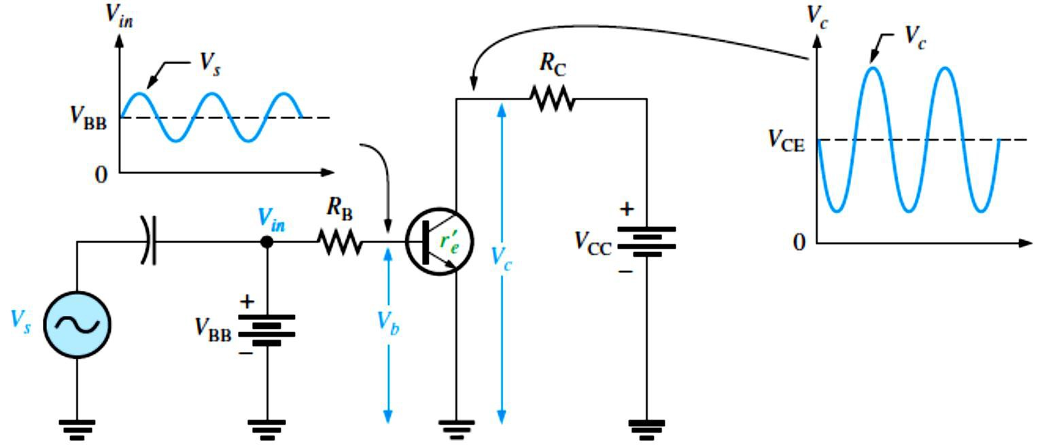
terminal to another. Single subscripted voltages such as �_{B}, �_{C}, and �_{E} are dc voltages from the transistor terminals to ground.
AC and all time-varying quantities always carry a lowercase italic subscript. For example, 𝐼� ,
𝐼� , and 𝐼_{𝑒}are the ac transistor currents. ���, ��� , and ���are the ac voltages from one transistor terminal to another. Single subscripted voltages such as �� , ��, and �_{𝑒}are ac voltages from the transistor terminals to ground.
The rule is different for internal transistor resistances. Transistors have internal ac resistances that are designated by lowercase 𝑟’ with an appropriate subscript. For example, the internal ac
emitter resistance is designated as 𝑟’_{𝑒}.
Circuit resistances external to the transistor itself use the standard italic capital R with a subscript that identifies the resistance as dc or ac (when applicable), just as for current and voltage. For example 𝑅_{E} is an external dc emitter resistance and 𝑅_{𝑒}is an external ac emitter resistance.
Voltage Amplification: As we have learned, a transistor amplifies current because the collector current is equal to the base current multiplied by the current gain, �.
The base current in a transistor is very small compared to the collector and emitter currents.
  Because of this, the collector current is approximately equal to the emitter current.
Let’s look at the circuit in Figure 4-15. An ac voltage, ��, is superimposed on the dc bias voltage �_{BB} by capacitive coupling as shown. The dc bias voltage �_{CC} is connected to the collector through the collector resistor, 𝑅_{C}.
The ac input voltage produces an ac base current, which results in a much larger ac collector current. The ac collector current produces an ac voltage across 𝑅_{C}, thus producing an
amplified, but inverted, reproduction of the ac input voltage in the active region of operation, as illustrated in Figure 4-15.
FIGURE 4-15: Basic transistor amplifier circuit with ac source voltage �� and dc bias voltage �_{BB} superimposed.
10

Slide 11
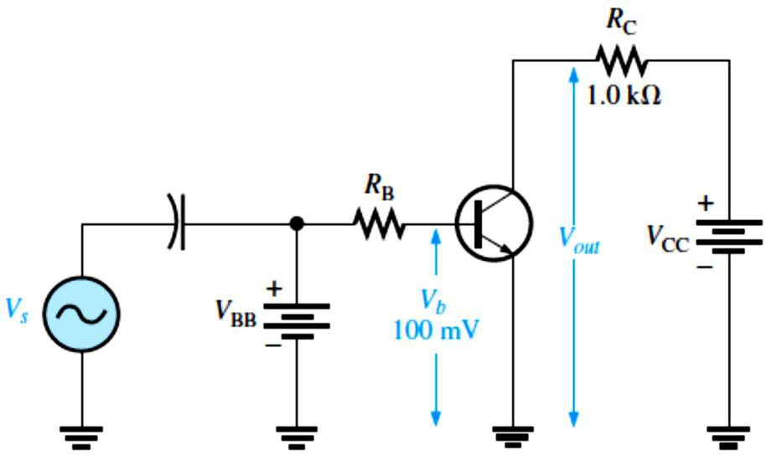
The forward-biased BE junction presents a very low resistance to the ac signal. This internal ac emitter resistance is designated 𝑟’_{𝑒}in Figure 4-15 and appears in series with 𝑅_{B}. The ac base voltage is
�� = 𝐼_{𝑒}𝑟’_{𝑒}
The ac collector voltage, ��, equals the ac voltage drop across 𝑅_{C}.
�� = 𝐼� 𝑅_{C}
Since 𝐼� ≅ 𝐼_{𝑒}the ac collector voltage is
�� ≅ 𝐼_{𝑒}𝑅_{C}
�� can be considered the transistor ac input voltage where �� = �� − 𝐼� 𝑅_{B}.
�� can be considered the transistor ac output voltage.
Since voltage gain is defined as the ratio of the output voltage to the input voltage, the ratio of �� to �� is the ac voltage gain, 𝐴�, of the transistor.
��
𝐴� = _{𝑉}
Substituting 𝐼_{𝑒}𝑅_{C} for �� and 𝐼_{𝑒}𝑟’_{𝑒}for �� yields
�
�� 𝐼_{𝑒}𝑅_{C}
𝐴� = _{𝑉}≅ _{𝐼}
𝑟’
The 𝐼_{𝑒}terms cancel; therefore,
� 𝑒𝑒
𝑅_{C}
𝐴� ≅ _{𝑟’}
Equation 4– 7
𝑒
Equation 4-7 shows that the transistor in Figure 4-15 provides amplification in the form of voltage gain, which is dependent on the values of 𝑅_{C} and 𝑟’_{𝑒}. Since 𝑅_{C} is always considerably larger in value than 𝑟’_{𝑒}, the output voltage for this configuration is greater than the input voltage. Various types of amplifiers are covered in detail in later Lectures.
EXAMPLE 4-9: Determine the voltage gain and the ac output voltage in Figure 4-16 if 𝑟’_{𝑒}= 50
Ω.
FIGURE 4-16
Solution The voltage gain is
𝐴� ≅ _{𝑟’}
𝑅_{C =} 1.0 kΩ
50 Ω
= 20
𝑒
Therefore, the ac output voltage is
���� = 𝐴� �� = (20)(100 mV)
���� = 2 V rms

Slide 12
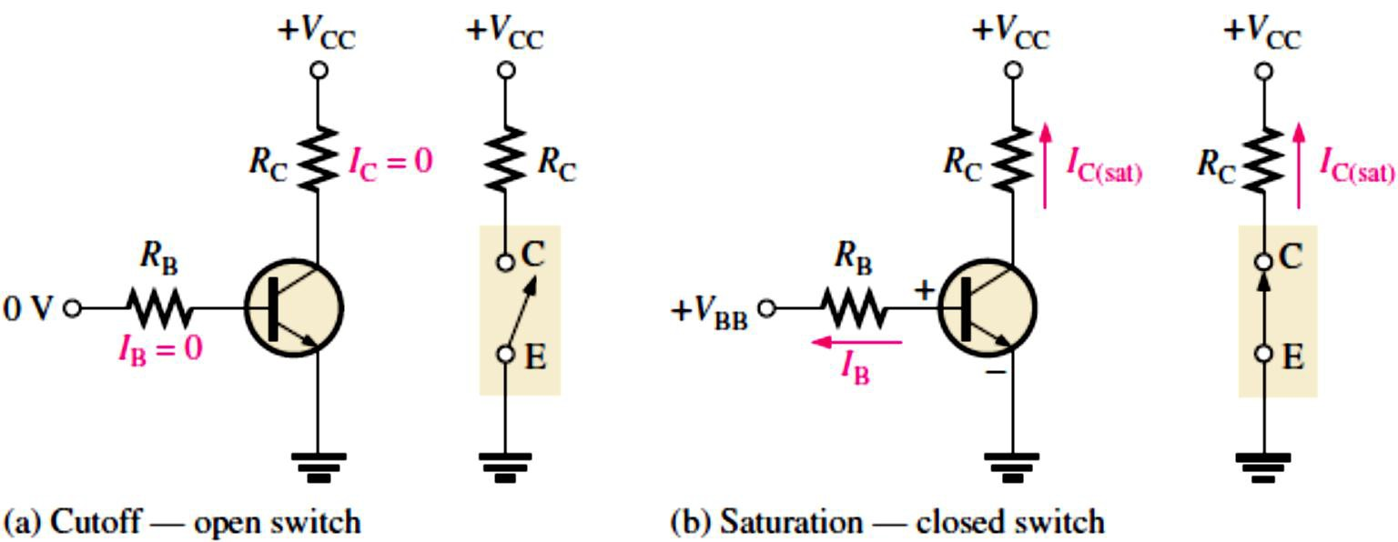
4.5 The BJT as a Switch
In the previous section, we saw how a BJT can be used as a linear amplifier.
The second major application area is switching applications, as shown in Figure 4-17.
  When used as an electronic switch, a BJT is normally operated alternately in cutoff and saturation. Many digital circuits use the BJT as a switch.
FIGURE 4-17: Switching action of an ideal transistor.
Conditions in Cutoff : In cutoff, both pn junctions are reverse-biased and there is essentially no collector current. The transistor ideally behaves like an open switch between collector and emitter. Neglecting leakage current, all of the currents are zero, and �_{CE} is equal to �_{CC}.
^{𝑽}��(𝐜���𝐟𝐟) ^{= 𝑽}��
Equation 4– 8
Conditions in Saturation: In saturation, both pn junctions are forward-biased and there is enough base current to produce a maximum collector current. The transistor ideally behaves like a closed switch between collector and emitter. The formula for collector saturation current:
^{𝑰}�(�𝐚�) ⁼
^{𝑽}�� ^{− 𝑽}��(�𝐚�)
Equation 4– 9
𝑹
�
Since �_{CE(sat)} is very small compared to �_{CC}, it can usually be neglected. The minimum value of base current needed to produce saturation is
^{𝑰}�(�𝐢�) ⁼
^{𝑰}�(�𝐚�)
Equation 4– 10
𝜷
��
Normally, 𝐼_{B} should be significantly greater than 𝐼_{B(min)} to ensure that the transistor is saturated.
EXAMPLE 4–10: (a) For the transistor circuit in Figure 4-18, what is �_{CE} when �_{IN} = 0 V?
What minimum value of 𝐼_{B} is required to saturate this transistor if �_{DC} is 200? Neglect �_{CE(sat)}.
Calculate the maximum value of 𝑅_{B} when �_{IN} = 5 V.

Slide 13
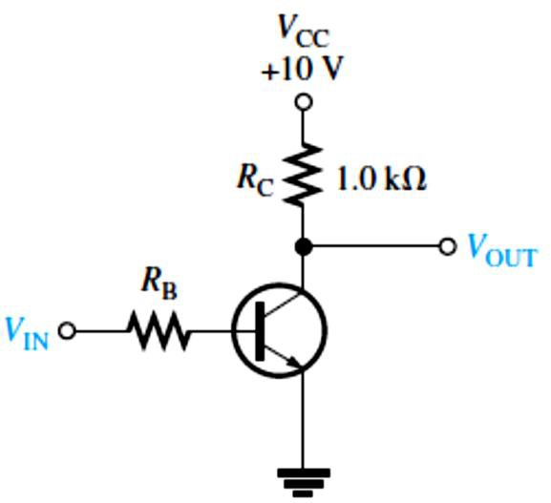
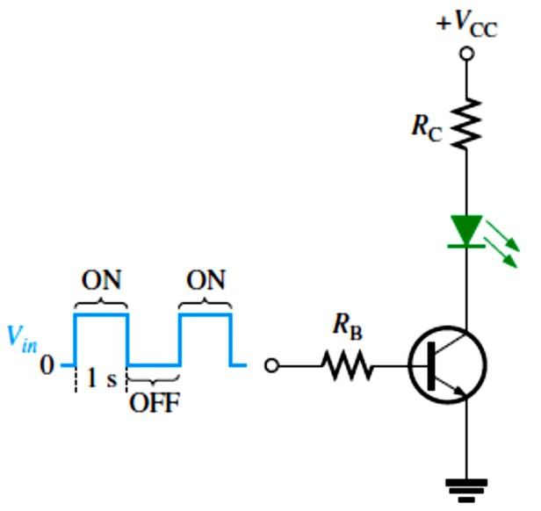
FIGURE 4-18
Solution (a) When �_{IN} = 0 V, the transistor is in cutoff (acts like an open switch) and
�_{CE} = �_{CC} = 10 V
(b) Since �_{CE(sat)} is neglected (assumed to be 0 V),
�CC ^{− �}CE(sat) �CC
10 V
^{𝐼}C(sat) ⁼
𝑅
= _{𝑅}= _{1.0 kΩ} = 10 mA
C C
^{𝐼}C(sat)
10 mA
^{𝐼}B(min) ⁼
�
= = 50 𝜇A
DC
200
This is the value of 𝐼_{B} necessary to drive the transistor to the point of saturation. Any further increase in 𝐼_{B} will ensure the transistor remains in saturation but there cannot be any further increase in 𝐼_{C}.
(c) When the transistor is on, �_{BE} ≅ 0.7 V. The voltage across 𝑅_{B} is
�_{𝑅B} = �_{IN} − �_{BE} ≅ 5 V − 0.7 V = 4.3 V
Calculate the maximum value of 𝑅_{B} needed to allow a minimum 𝐼_{B} of 50 𝜇A using Ohm’s law as follows:
^{𝑅}B(max) ⁼ _{𝐼}
�_{RB}
4 . 3 V
= = 86 kΩ 50 μA
B(min)
A Simple Application of a Transistor Switch: The transistor in Figure 4-19 is used as a switch to turn the LED on and off. For example, a square wave input voltage with a period of 2 s is applied to the input as indicated. When the square wave is at 0 V, the transistor is in cutoff; and since there is no collector current, the LED does not emit light. When the square wave goes to its high level, the transistor saturates. This forward-biases the LED, and the resulting collector current through the LED causes it to emit light. Thus, the LED is on for 1 second and off for 1 second.
FIGURE 4-19: A transistor used to switch an LED on and off.

Slide 14
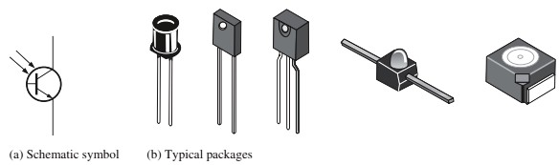
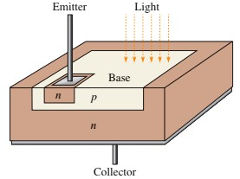
EXAMPLE 4-11: The LED in Figure 4-19 requires 30 mA to emit a sufficient level of light. Therefore, the collector current should be approximately 30 mA. For the following circuit values, determine the amplitude of the square wave input voltage necessary to make sure that the transistor saturates. Use double the minimum value of base current as a safety margin to ensure saturation. �_{CC} = 9V, �_{CE(sat)} = 0.3 V, 𝑅_{C} = 220 Ω, 𝑅_{B} = 3.3 k Ω, �_{DC} = 50, and �_{LED} = 1.6 V.
Solution
�CC ^{− �}LED ^{− �}CE(sat)
9 V − 1.6 V − 0.3 V
^{𝐼}C(sat) ⁼
𝑅
= = 32.3 mA
C
220 Ω
^{𝐼}C(sat)
32.3 mA
^{𝐼}B(min) ⁼
�
= = 646 𝜇A
DC
50
To ensure saturation, use twice the value of 𝐼_{B(min)}, which is 2× 646𝜇A = 1.29 mA. Use Ohm’s law to solve for �_{𝑖�}.
�_{𝑅B}
�𝑖� ^{− �}BE
�_{𝑖�} − 0.7 V
𝐼_{B} = _{𝑅}=
=
B B
𝑅3.3 k Ω
�_{𝑖�} − 0.7 V = 2𝐼_{B(min)}𝑅_{B} = (1.29 mA) ( 3.3 k Ω)
�_{𝑖�} = (1.29 mA)(3.3 k Ω) + 0.7 V = 4.96 V
4.6 The Phototransistor
A phototransistor, as shown in Figures 20 and 21, is similar to a regular BJT except that the base current is produced and controlled by incident light instead of a voltage source.
  The phototransistor effectively converts light energy to an electrical signal.
  The relationship between the 𝐼_{C} and the light-generated base current �_{𝜆}in a phototransistor:
𝑰� = 𝜷�� 𝑰_{𝝀}
Equation 4– 11
A phototransistor can be either a two-lead or a three-lead device and it is used in a light- operated relay circuit.
FIGURE 4-20:
Phototransistor.
FIGURE4-21: Typical phototransistor structure.

Slide 15
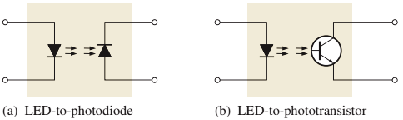
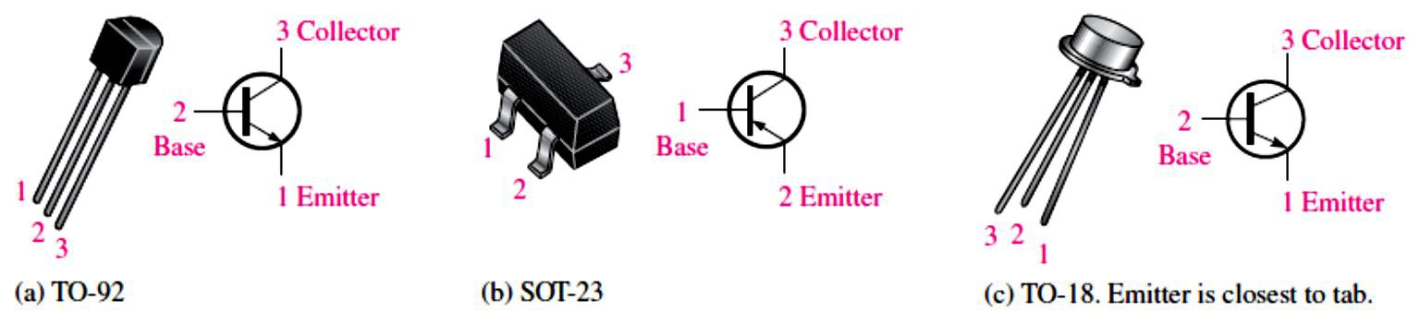
Optocouplers: An optocoupler uses an LED optically coupled to a photodiode or a phototransistor in a single package.
  Two basic types are LED-to-photodiode and LED-to-phototransistor, as shown in Figure 4-22.
Optocouplers are used to isolate sections of a circuit that are incompatible in terms of the voltage levels or currents required.
  For example, they are used to protect hospital patients from shock when they are connected to monitoring instruments or other devices.
  They are also used to isolate low-current control or signal circuits from noisy power supply circuits or higher-current motor and machine circuits.
FIGURE 4-22: Basic optocouplers.
4.7 Transistor Categories and Packaging
There are many types of transistor packages using plastic, metal, or ceramic.
Manufacturers generally classify bipolar junction transistors into three broad categories: general-purpose/small-signal devices, power devices, and RF (radio frequency/microwave)
devices. Each of these categories has its own unique package types.
General-Purpose/Small-Signal Transistors are generally used for low- or medium-power amplifiers or switching circuits. The packages are either plastic or metal cases. Certain types
of packages contain multiple transistors. Figure 4-23 illustrates two common plastic cases and a metal can package.
FIGURE 4-23: Plastic and metal cases for general-purpose/small-signal transistors. Pin configurations may vary.

Slide 16
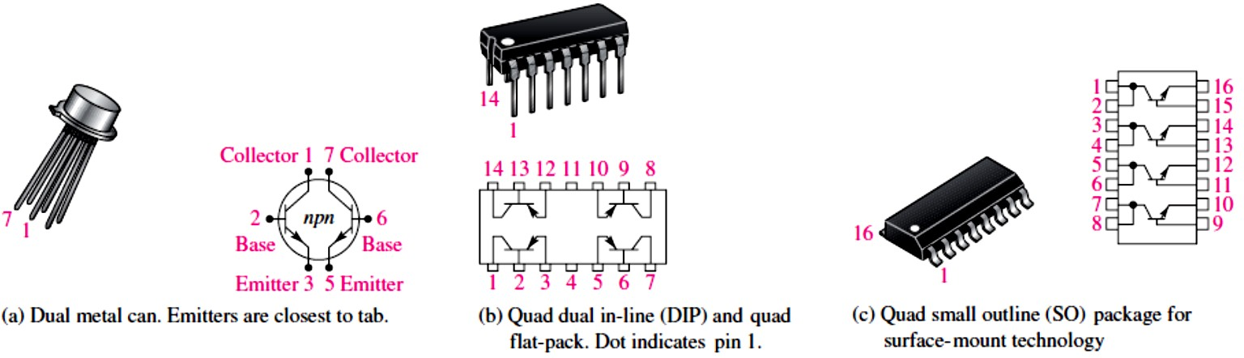
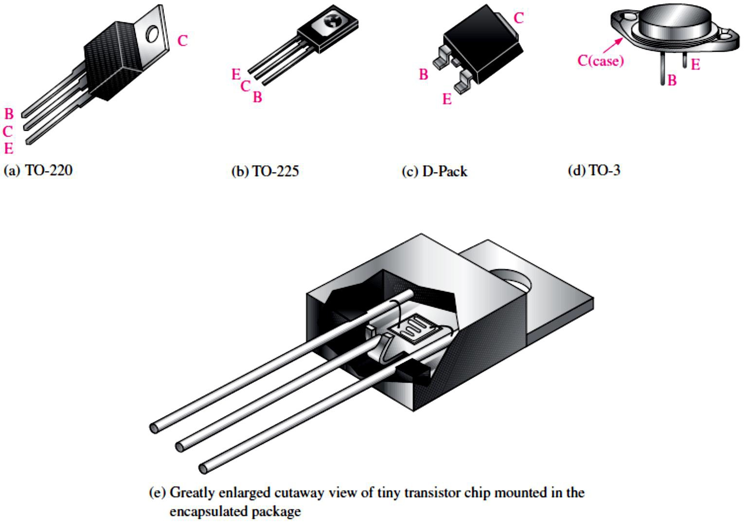
Figure 4-24 shows multiple-transistor packages. Some of the multiple-transistor packages such as the dual in-line (DIP) and the small-outline (SO) are the same as those used for many integrated circuits. Typical pin connections are shown so we can identify the emitter, base, and collector.
FIGURE 4-24: Examples of multiple-transistor packages.
Power Transistors are used to handle large currents (typically more than 1 A) and/or large voltages.
  For example, the final audio stage in a stereo system uses a power transistor amplifier to drive the speakers. Figure 4-25 shows some common package configurations. The metal tab or the metal case is common to the collector and is thermally connected to a heat sink for heat dissipation. In part (e) the small transistor chip is mounted inside the much larger package.
FIGURE 4-25: Examples of power transistors and packages.

Slide 17
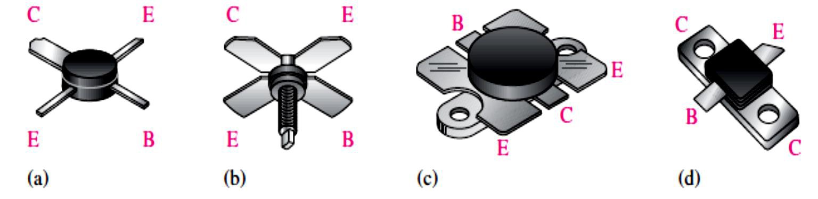
RF Transistors are designed to operate at extremely high frequencies and are commonly used for various purposes in communications systems and other high frequency applications.
  Their unusual shapes and lead configurations are designed to optimize certain high- frequency parameters. Figure 4-26 shows some examples.
FIGURE 4-26: Examples of RF transistor packages.

